Slide 1

Health care
Medical costs

Slide 2

Medical Costs
Medical costs refer to the expenses incurred for medical services and treatments. These costs can vary widely depending on several factors, including the type of medical services, geographic location, patient demographics, and individual health conditions.
It includes various attributes such as age, sex, BMI, number of children, smoking status, and region. These attributes are essential in understanding the factors that influence medical costs and can be used for predictive modelling, statistical analysis, and research purposes.

Slide 3
Use case
Trend Analysis of Medical Costs by Age:
Analize how medical costs vary across different age groups to identify which age groups incur the highest expenses and for which types of services
Smoking and Medical Costs:
Compare the medical costs of smokers versus non-smokers to quantify the financial impact of smoking on healthcare systems.

Slide 4
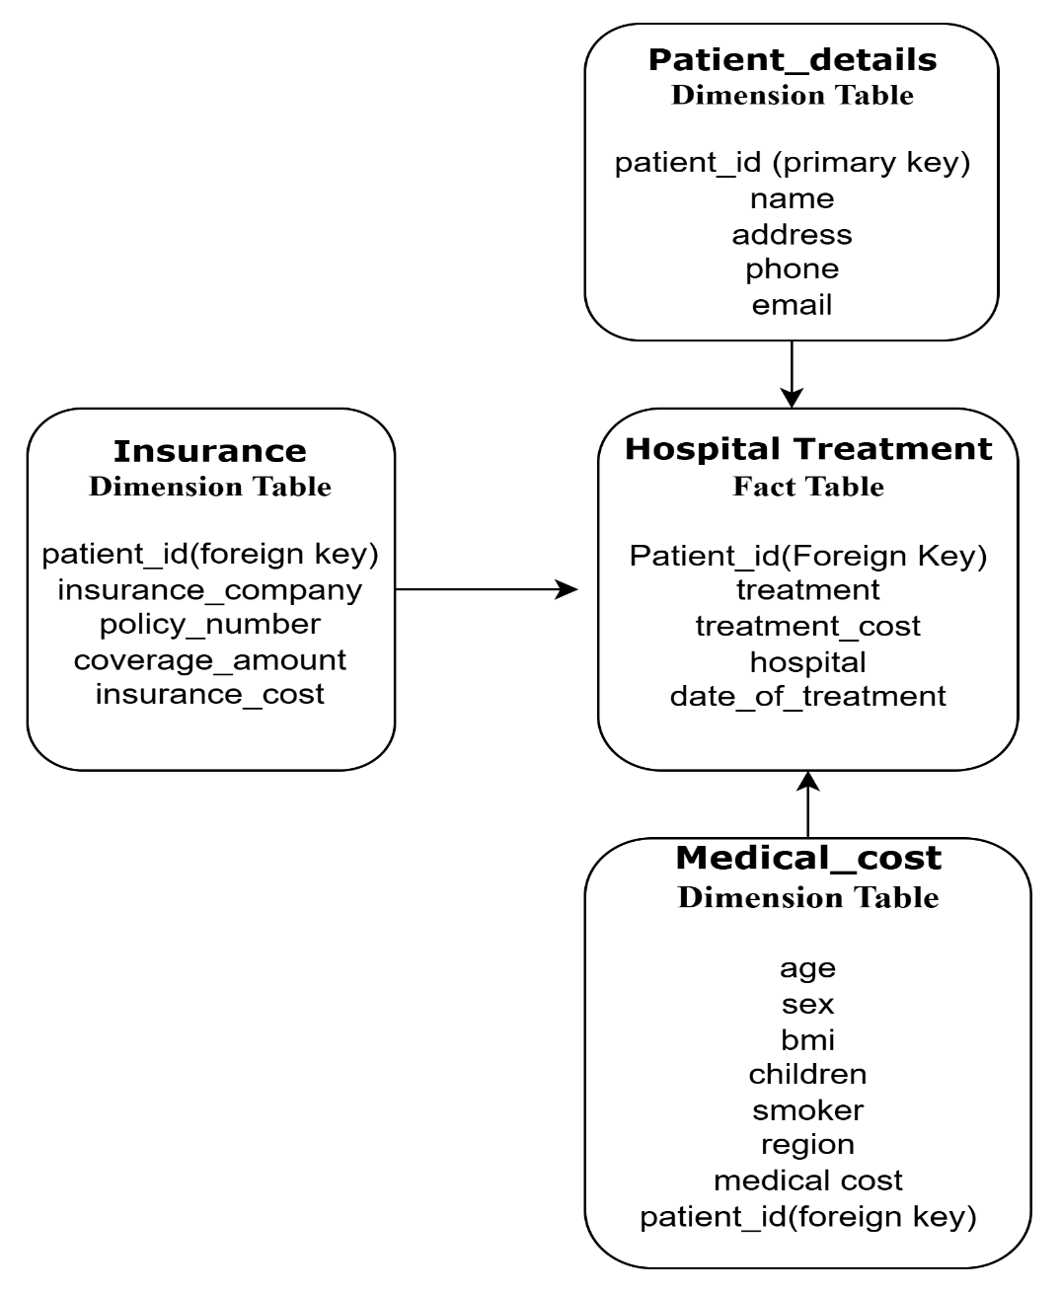
Data model – star schema

Slide 5
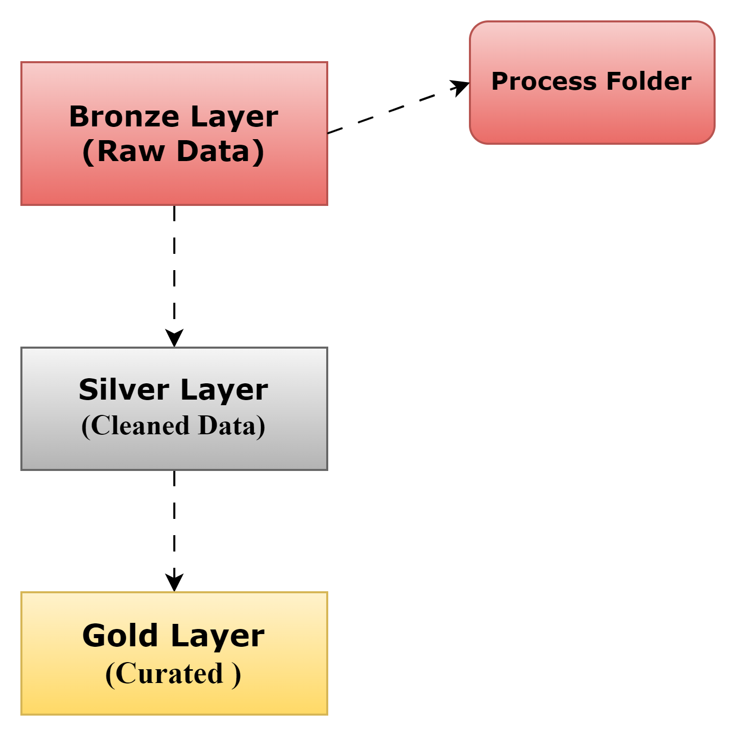
Medallion Architecture

Slide 6
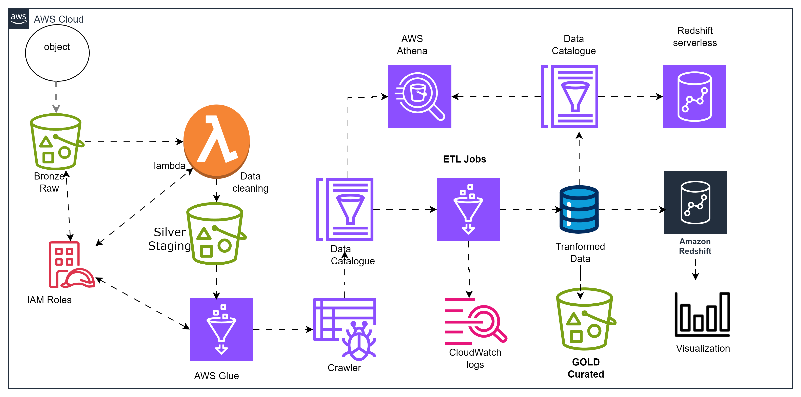
End-to-End Flow of Project - AWS
Batch Processing

Slide 7
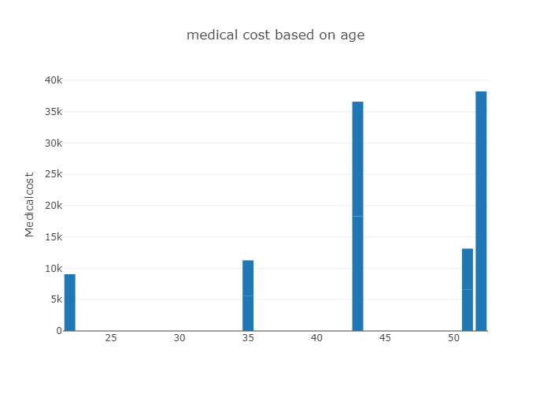
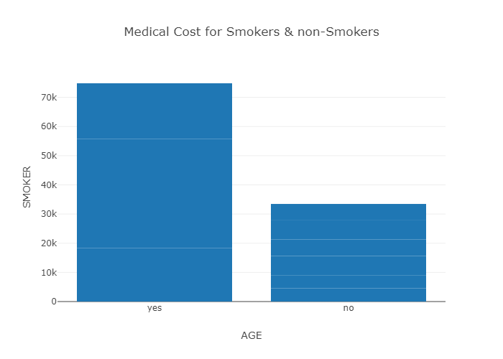
Visualization

Slide 8
AWS Services Used:
S3 bucket
IAM – Identity & Access Management
Lambda
AWS Glue : Crawler, Data Catalog, ETL Jobs
Cloudwatch
Aws Athena
Kinesis
Redshift

Slide 9
Challenges Faced
Creating tables using crawler one of my file showing errors due to delimiters.
Cloudwatch logs helped in finding out errors while running lambda as well as ETL jobs.
Writing cleaned dataframes back to the silver folder in Azure, with errors encountered along the way.
Future enhancements
Will try to implement Incremental loads – Inserts, Updates and deletes in Batch Processing.
Automating the process leads to greater efficiency, reliability, and agility in handling data and repetitive tasks.
Will try to implement the entire AWS project pipeline using infrastructure as a code (Terraform)
Will try to complete end-to-end project in Azure

Slide 10
Questions?

